Slide 1
TOPIC A3:
DATABASES
LESSON A3-1
DATABASES

Slide 2
AGENDA
Flowcharts
Flowchart Symbols
NOTE!
Have a way to take notes and a way to write code available for this lesson

Slide 3

THE WARM UP QUESTION
Write a plain text algorithm for how you get ready for school in the morning

Slide 4
THE WARM UP ANSWER
Snooze my alarm (x6)
Roll out of bed
Turn on the shower
Feed my snorlax in Pokemon Sleep (shower warms up)
Take shower
Get Dressed
Pack Lunch
Leave

Slide 5
MY COMPANY RN
https://docs.google.com/spreadsheets/d/1Iylat463c5wrgJVlwR3AgOrwAVyIDjRuXRRn4TrTPaQ/edit?usp=sharing

Slide 6
SUMMARIZING
What issues do we run into when multiple people try to manage large sets of related information using simple files or spreadsheets?

Slide 7
DATABASES
These are the problems that databases were created to solve
But, as with anything in this world, they have their own set of issues

Slide 8
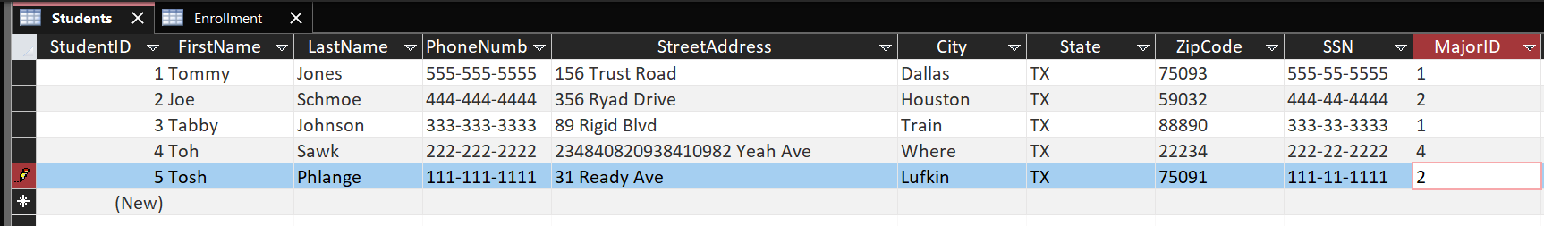
DATABASES
Databases look and work a lot like spreadsheets
They have a few more requirements that help to keep data organized

Slide 9
DATABASES
A table in a database is called an entity or table
A specific row from a table is called a record
This represents a specific instance of an entity

Slide 10
DATABASES
A column in a database is called an attribute or field
And a specific record’s attribute is called a value

Slide 11
DATABASES
Certain attributes can be candidate key attributes
A candidate key can be used to uniquely identify a record in an entity
In this entity, the candidate keys are ID and SSN, as those two values should never be the same for two people

Slide 12
DATABASES
One of the two candidate keys is then selected to be the primary key of the entity
This is used as the main way to access a specific record
A candidate key that isn’t selected as the primary key is known as a secondary key

Slide 13
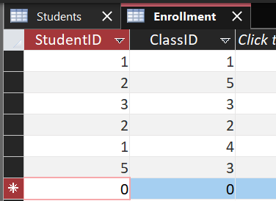
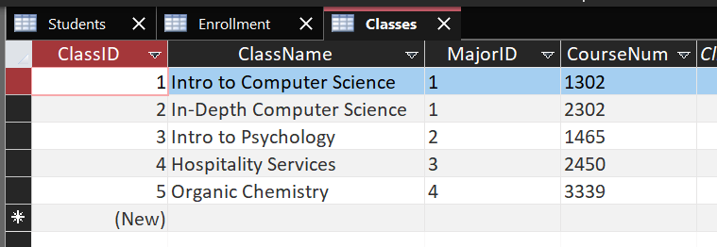
DATABASES
In unique cases, we may not have a field that can be a primary key for an entity
In these cases, if a combination of two (or more) attributes can uniquely identify a record
Students can’t be enrolled in the same class twice, so the unique combo of StudentID and ClassID create a composite key

Slide 14
DATABASES
You’ll notice that across our entities there are some shared values
StudentID and ClassID both appear in Enrollment
MajorID appears in both Student and Classes

Slide 15
DATABASES
While we can’t see the Majors entity, we can assume MajorID is its primary key, and we know StudentID and ClassID are primary keys
When a primary key from one entity appears in another entity it’s known as a foreign key in that entity, as it is from another entity

Slide 16
DATABASES
When a field is a foreign key, it can only have values that appear in the original table’s records
If I try to make an enrollment with StudentID of 6 and ClassID of 5 it would fail because there is not StudentID of 6

Slide 17
DATABASES
In a relational database entities are linked using these foreign keys to create relationships (creative name, huh?)
Relationships can fall into three categories:
One to one
Many to one
Many to many

Slide 18
DATABASES
What we’ve been looking at is a many to many relationship
Many students are enrolled in Many classes
A one to many relationship in this setup might be teachers and classes
One teacher teaches many classes, but each class is taught by only one teacher
A one to one relationship in this setup is a bit harder to find
A student may have a one to one relationship with parking passes
Each student gets one parking pass, each parking pass may only be used by one student

Slide 19
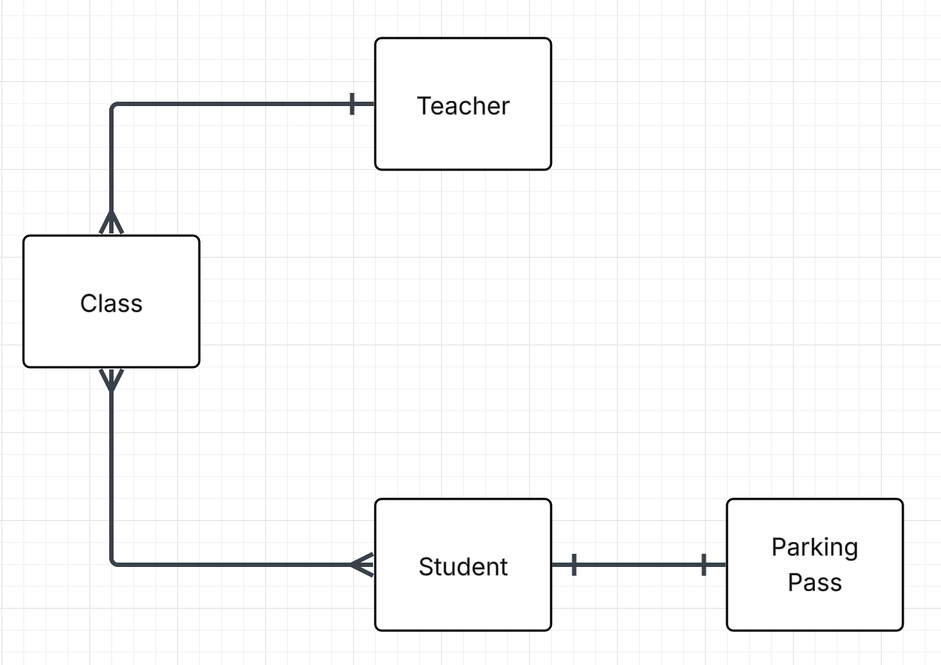
DATABASES
Crow’s foot for many
Single line for one
Note the lack of enrollment here
Enrollment is a helper table
Helper tables are required for any many to many relationship
Helper tables join the many of one to the many of another
Helper tables often use composite keys

Slide 20
DATABASES
Create a small Entity Relationship Diagram of a small system
Library, school, online shop, etc.

Slide 21
DATABASE FEATURES
Databases provide lots of features other than just storing data of course, let’s look at some of them

Slide 22
COMMUNITY SUPPORT
Many database programs are widely used and have large followings
Programs like Microsoft Access (what we’ll be using), MySQL, SQLite, and PostgreSQL have massive communities
Tons of documentation
Walkthroughs & guides
Professional resources and training

Slide 23
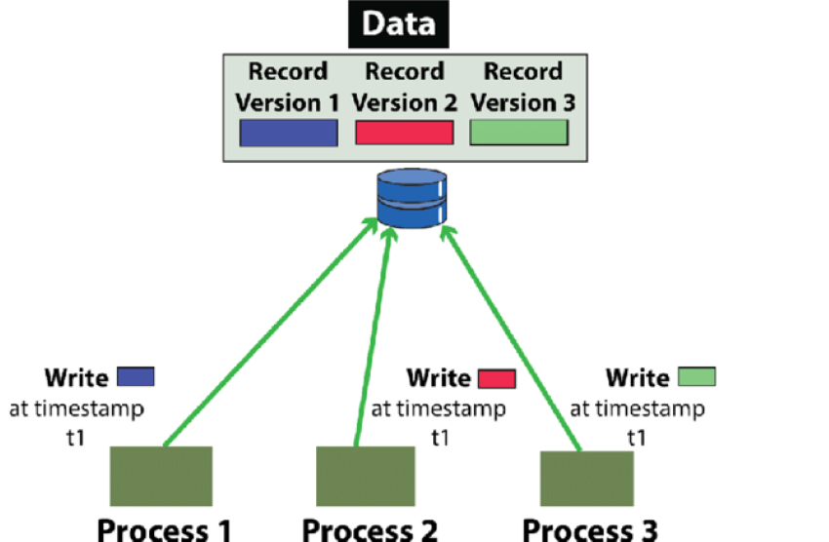
CONCURRENCY CONTROL
Databases provide concurrency control
Concurrency allows for multiple users to access and enter data safely without messing with each other’s edits
This usually occurs by deciding a definitive order that changes are made in using the system clock
If I try to modify a database at the same time as you, the computer will store this information so nobody’s data is lost

Slide 24
CONSISTENCY AND INTEGRITY
Unlike a spreadsheet, you can’t just type whatever you want in a database
Databases require data to meet certain formatting requirements
You can’t type a date as “joe” for example
Keys also ensure that no data is added to a database that would be duplicate

Slide 25

DATA RETRIEVAL
You obtain data from a database by querying it using SQL (structured query language)
More on this to come in later lessons

Slide 26
REDUCED DUPLICATION & REDUNDANCY
Because we can store data using multiple tables that relate to each other, we can reduce how much data is duplicated and therefore redundant
Our spreadsheet had lots of repeated information that our database doesn’t

Slide 27
RELIABLE TRANSACTIONS
If adding something to a database goes wrong, the database can roll back to a previous state to prevent disaster

Slide 28
SCALABILITY & SECURITY
Databases can get a whole lot bigger than a spreadsheet
You can also lock certain data behind different user accounts to protect information
Much more on this to come later down the line

Slide 29
LIMITATIONS OF DATABASES
Databases can’t do everything though…
Lots of companies have so much data that keeping it all on one database would be impossible
This is known as BIG DATA
To solve this companies often use NoSQL databases or distributed databases that take multiple computers at multiple locations
Databases have rigid layouts, also known as schemas
These are very difficult to change when created, and so databases may not be flexible for every organization

Slide 30
LIMITATIONS OF DATABASES
Object-oriented data layouts do not always match perfectly with databases
More information about this in the OOP unit
Database design can be complicated and expensive
This isn’t always the best option, especially for a small business

Slide 31
LAB
Design a small relational database for a hospital appointment system
Identify
Entities and keys
Define relationships

Slide 32

VOCABULARY TO REMEMBER
Entity
Record
Attribute
Value
Primary Key
Secondary Key
Candidate Key
Composite Key
One to One Relationship
One to Many Relationship
Many to Many Relationship
Entity Relationship Diagram
BIG DATA
Concurrency
Redundancy
Schema

